Slide 1
.ng cctld registry Technical overview
Muhammed Rudman
m.rudman@ixp.net.ng
www.nira.org.ng
14-09-2011

Slide 2
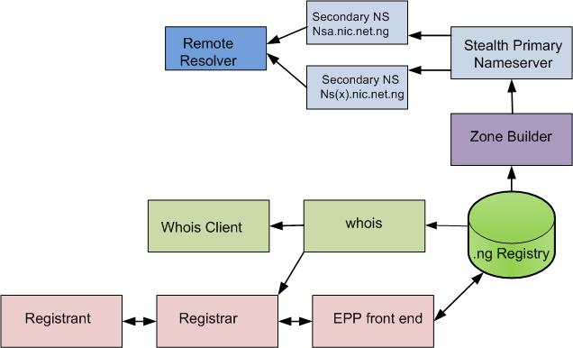
The .ng Registry Design
3R Registry Model
Public WHOIS server on port 43
Public WHOIS web interface
EPP interface for the registrars
Escrow backup with Cocca
Stealth Primary Server
SSH with user & IP restrictions

Slide 3
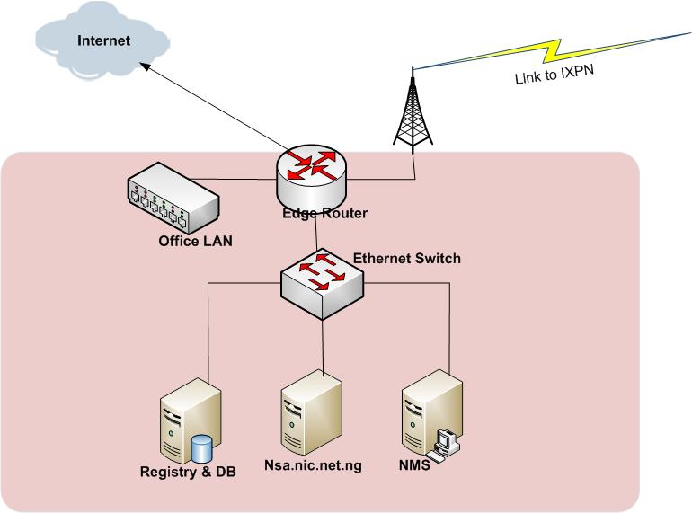
The .ng ccTLD network Architecture
The registry
CentOS 5.2
Cocca registry software (web & EPP)
PostgreSQL Data Base software
Bind DNS software
Primary Stealth DNS
Nsa.nic.net.ng
Open BSD
Bind DNS Software
NMS
Tembria Server Monitor
Paessler PRTG
Kayoka helpdesk
Warm standby Router & Switch

Slide 4
New Power Design
Motorized Automatic Voltage Regulators (AVR) for each power source
Double Power source
Dual Automatic Transfer Switch (ATS)
Multiple Power packs in each equipment
Remote monitoring of power, with ability shutdown devices remotely

Slide 5
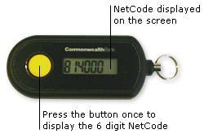
The New Network Design- Under review
Redundant Site
Fiber and Radio linking the two sites using VPN channel
Multiple ISPs with diversity in uplink transit provider
Multiple replication of registry Database with all nodes available
Onsite and offsite backup system
Multiple firewalls (stateful & stateless ) with Intrusion Detection System
Dual authentication to all registrars into the registry: login details with either IP restrictions or Token

Slide 6
Network Monitoring

Slide 7
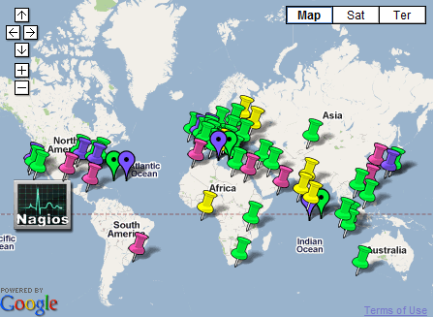
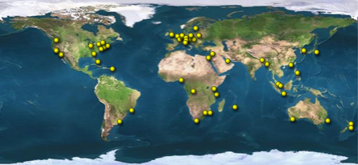
Secondary Name Servers
ns1.nic.net.ng 194.0.1.29 I
Internet Computer Bureau
ns2.nic.net.ng 204.61.216.40
WoodyNet (PCH)
ns3.nic.net.ng 208.78.70.93
Dynamic Network Services
ns4.nic.net.ng 204.13.250.93
Dynamic Network Services
nsa.nic.net.ng 41.222.79.3
Nigeria
nsb.nic.net.ng 72.167.122.8
GoDaddy.com (Recently removed)

Slide 8
Thank you
Questions ?

